Slide 1
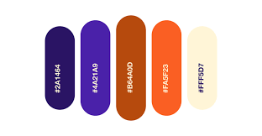
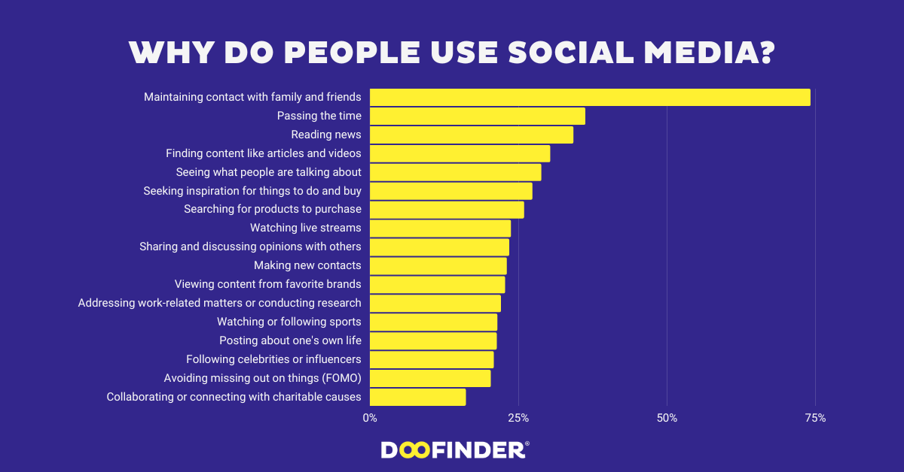
SOCIAL MEDIA
Professor Belhadi Abdelkader

Slide 2
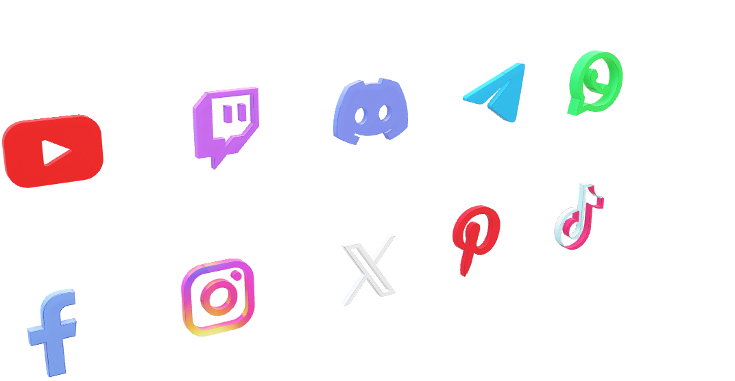
This is currently the most impactful social media platform in the world.
SOCIAL MEDIA
This is currently the most impactful social media platform in the world.

Slide 3
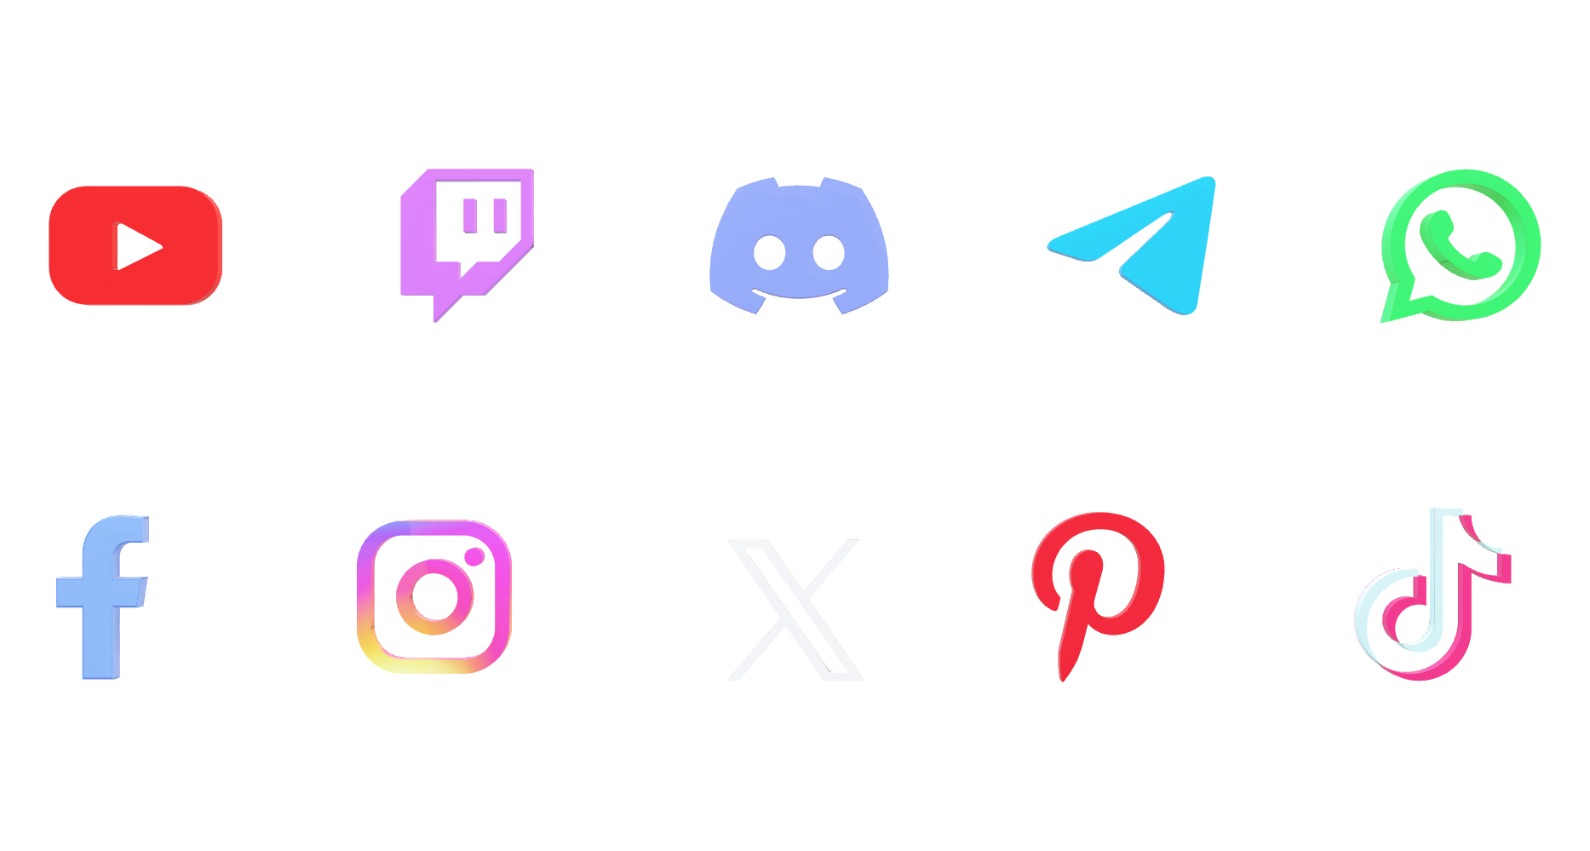
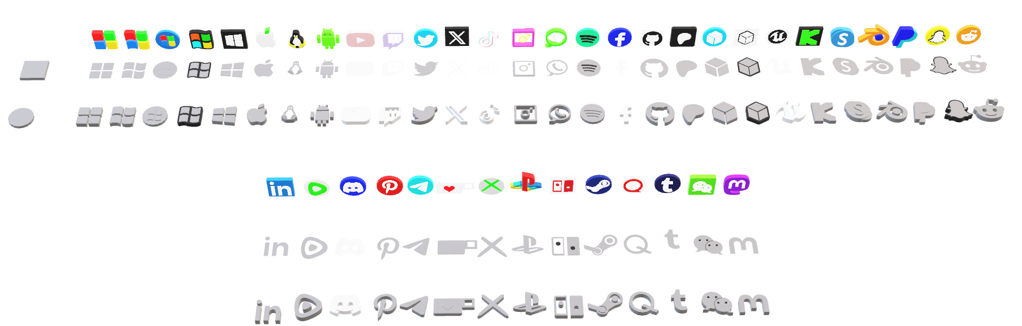
This is currently the most impactful social media platform in the world.
SOCIAL MEDIA
X, formerly known as Twitter, is a social media platform founded in March 2006 by Jack Dorsey, Biz Stone, Evan Williams and Noah Glass. Designed for real-time communication, it allows users to post and interact with short messages called "tweets" of only 280 characters. X has become a hub for news, social commenting and networking, with more than 400 million monthly users. Its unique features, such as trending topics and hashtags, facilitate conversations about current events, making it a staple in a digital landscape
Pinterest is a visual platform where users can search and store ideas through images, known as "pins." Launched in 2010, it works like a digital scrapbook, allowing users to create theme boards for interests such as fashion, home decor, recipes, and more. The platform fosters creativity and inspiration, making it the go-to resource for planning projects and spotting trends.
TikTok is a popular social media app that allows users to create and share short videos, usually set to music or audio clips. Launched in 2016 and it quickly gained huge popularity especially among younger audiences due to its interesting features like filters, effects and editing tools, users can explore different things from dance challenges and comedy skits to educational trivia, it was a vibrant platform for creativity and entertainment
Facebook is a massive social media platform founded in January 2004 by Mark Zuckerberg and his roommate in college. Originally conceived as a place for college students to network, it quickly expanded to include people of all ages. Acquired by Meta (formerly known as Facebook, Inc.) in 2021, Facebook allows users to communicate with friends, share updates, and engage with content through features such as News Feeds, Groups, and Marketplace. Facebook has over 2.9 billion monthly active users It has become a powerful tool for communication, social interaction and digital marketing, increasingly reflecting how we connect and share in the digital age
Instagram is a visually-focused social media platform founded in October 2010 by Kevin Systrom and Mike Krieger. Originally designed to allow users to share photos and videos, it quickly became popular for its ease of use and exciting features. Acquired by Facebook in 2012, Instagram has grown to include Stories, Reels and IGTV functionality, making it a platform for creativity and interaction. With more than 2 billion monthly active users, it plays a key role in shaping digital networks around the world, influencing growth and driving marketing strategies
Facebook is a massive social media platform founded in January 2004 by Mark Zuckerberg and his roommate in college. Originally conceived as a place for college students to network, it quickly expanded to include people of all ages. Acquired by Meta (formerly known as Facebook, Inc.) in 2021, Facebook allows users to communicate with friends, share updates, and engage with content through features such as News Feeds, Groups, and Marketplace. Facebook has over 2.9 billion monthly active users It has become a powerful tool for communication, social interaction and digital marketing, increasingly reflecting how we connect and share in the digital age
Instagram is a visually-focused social media platform founded in October 2010 by Kevin Systrom and Mike Krieger. Originally designed to allow users to share photos and videos, it quickly became popular for its ease of use and exciting features. Acquired by Facebook in 2012, Instagram has grown to include Stories, Reels and IGTV functionality, making it a platform for creativity and interaction. With more than 2 billion monthly active users, it plays a key role in shaping digital networks around the world, influencing growth and driving marketing strategies
FACBOOK

Slide 4

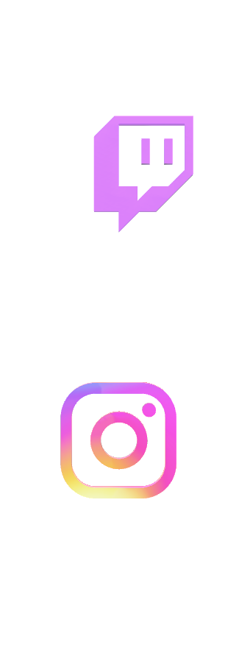
This is currently the most impactful social media platform in the world.
This is currently the most impactful social media platform in the world.
Facebook is a massive social media platform founded in January 2004 by Mark Zuckerberg and his roommate in college. Originally conceived as a place for college students to network, it quickly expanded to include people of all ages. Acquired by Meta (formerly known as Facebook, Inc.) in 2021, Facebook allows users to communicate with friends, share updates, and engage with content through features such as News Feeds, Groups, and Marketplace. Facebook has over 2.9 billion monthly active users It has become a powerful tool for communication, social interaction and digital marketing, increasingly reflecting how we connect and share in the digital age
Instagram is a visually-focused social media platform founded in October 2010 by Kevin Systrom and Mike Krieger. Originally designed to allow users to share photos and videos, it quickly became popular for its ease of use and exciting features. Acquired by Facebook in 2012, Instagram has grown to include Stories, Reels and IGTV functionality, making it a platform for creativity and interaction. With more than 2 billion monthly active users, it plays a key role in shaping digital networks around the world, influencing growth and driving marketing strategies
FACBOOK

Slide 5
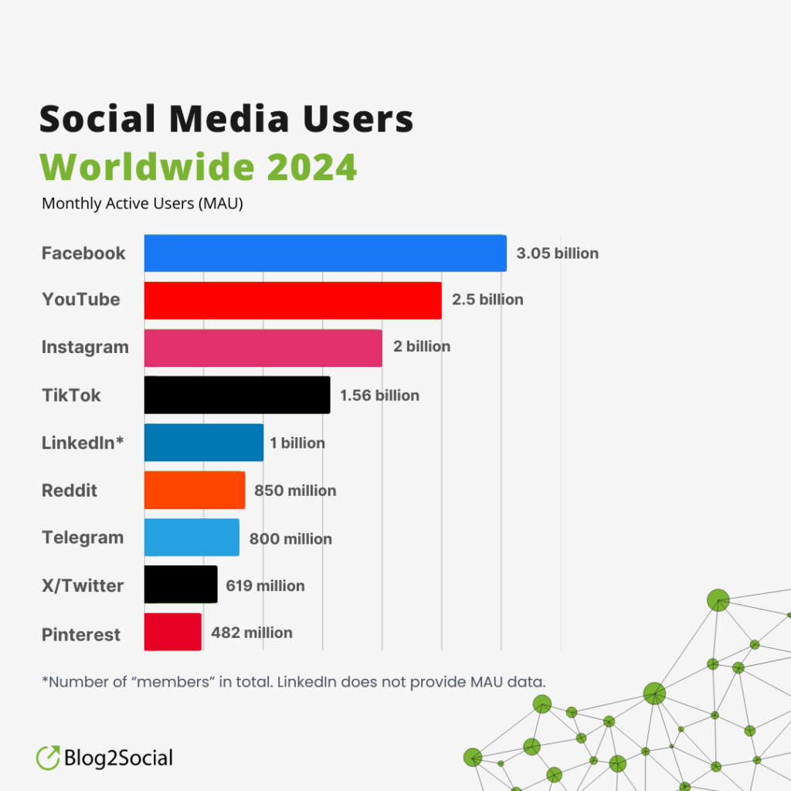

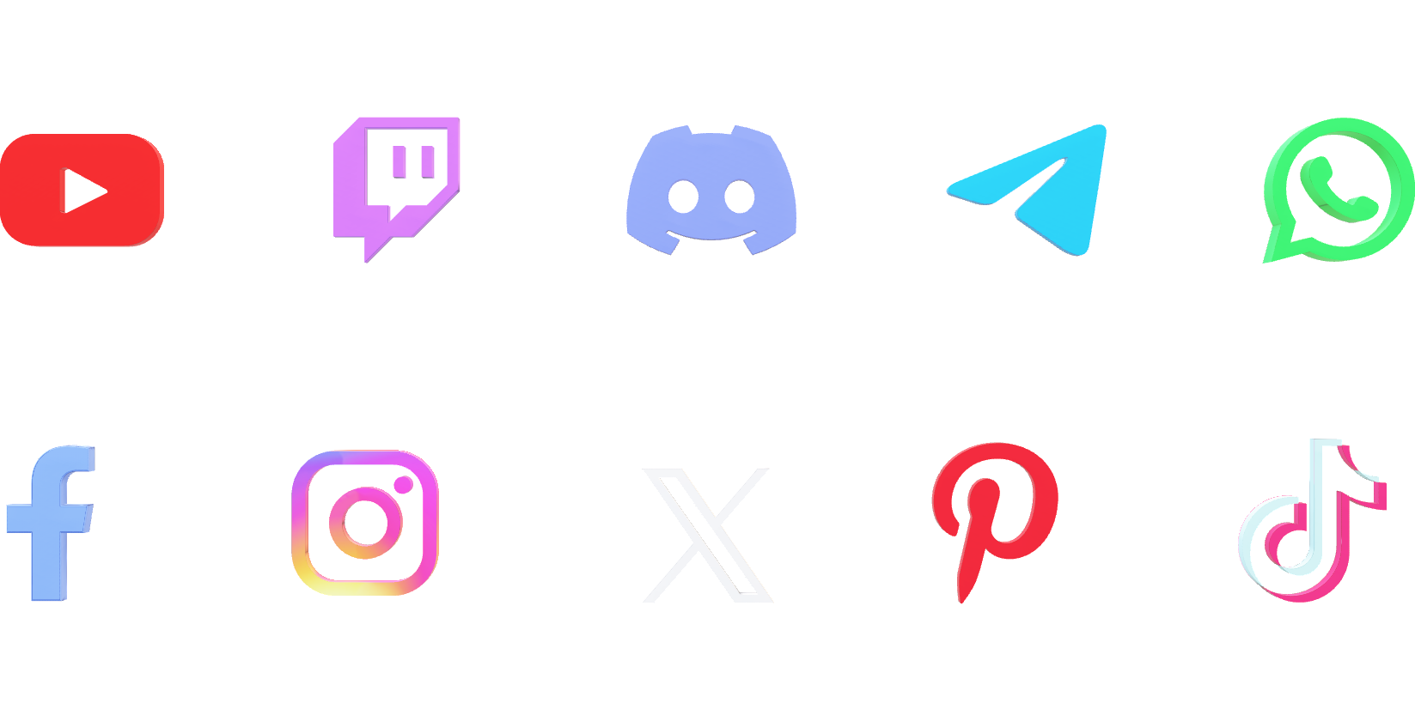

This is currently the most impactful social media platform in the world.
Twitch is a live streaming platform primarily focused on video game content, allowing users to watch and interact with streamers in real-time. Launched in 2011, it has evolved into a vibrant community where gamers, artists, and creators can share their experiences and connect with audiences. In addition to gaming, Twitch features streams on music, art, and various other topics, making it a diverse hub for entertainment and engagement. With chat functionalities and interactive features, Twitch fosters a unique sense of community among viewers and streamers alike.
Discord is a communication platform designed for creating communities, originally popular among gamers. Launched in 2015, it offers voice, video, and text chat features, allowing users to connect in real-time through servers organized around various topics and interests. Whether for gaming, study groups, or hobbyist communities, Discord provides a space for collaboration and socializing. With customizable channels and robust moderation tools, it fosters vibrant, interactive environments for people to share, discuss, and connect.
Telegram is a cloud-based messaging app known for its focus on speed and security. Launched in 2013, it allows users to send messages, photos, videos, and files, as well as create groups and channels for broadcasting to larger audiences. With features like end-to-end encryption and self-destructing messages, Telegram emphasizes privacy and user control. Its versatility makes it popular for both personal communication and community building, accommodating a wide range of interests and interactions.
WhatsApp is a widely-used messaging app that allows users to send text messages, voice notes, photos, and videos over the internet. Launched in 2009, it enables real-time communication through one-on-one chats or group conversations. With features like end-to-end encryption, voice and video calls, and status updates, WhatsApp prioritizes user privacy and connectivity. Its simplicity and accessibility have made it a go-to app for millions around the world, facilitating both personal and professional communication.
Facebook is a massive social media platform founded in January 2004 by Mark Zuckerberg and his roommate in college. Originally conceived as a place for college students to network, it quickly expanded to include people of all ages. Acquired by Meta (formerly known as Facebook, Inc.) in 2021, Facebook allows users to communicate with friends, share updates, and engage with content through features such as News Feeds, Groups, and Marketplace. Facebook has over 2.9 billion monthly active users It has become a powerful tool for communication, social interaction and digital marketing, increasingly reflecting how we connect and share in the digital age
Instagram is a visually-focused social media platform founded in October 2010 by Kevin Systrom and Mike Krieger. Originally designed to allow users to share photos and videos, it quickly became popular for its ease of use and exciting features. Acquired by Facebook in 2012, Instagram has grown to include Stories, Reels and IGTV functionality, making it a platform for creativity and interaction. With more than 2 billion monthly active users, it plays a key role in shaping digital networks around the world, influencing growth and driving marketing strategies
X, formerly known as Twitter, is a social media platform founded in March 2006 by Jack Dorsey, Biz Stone, Evan Williams and Noah Glass. Designed for real-time communication, it allows users to post and interact with short messages called "tweets" of only 280 characters. X has become a hub for news, social commenting and networking, with more than 400 million monthly users. Its unique features, such as trending topics and hashtags, facilitate conversations about current events, making it a staple in a digital landscape
Pinterest is a visual platform where users can search and store ideas through images, known as "pins." Launched in 2010, it works like a digital scrapbook, allowing users to create theme boards for interests such as fashion, home decor, recipes, and more. The platform fosters creativity and inspiration, making it the go-to resource for planning projects and spotting trends.
TikTok is a popular social media app that allows users to create and share short videos, usually set to music or audio clips. Launched in 2016 and it quickly gained huge popularity especially among younger audiences due to its interesting features like filters, effects and editing tools, users can explore different things from dance challenges and comedy skits to educational trivia, it was a vibrant platform for creativity and entertainment
X, formerly known as Twitter, is a social media platform founded in March 2006 by Jack Dorsey, Biz Stone, Evan Williams and Noah Glass. Designed for real-time communication, it allows users to post and interact with short messages called "tweets" of only 280 characters. X has become a hub for news, social commenting and networking, with more than 400 million monthly users. Its unique features, such as trending topics and hashtags, facilitate conversations about current events, making it a staple in a digital landscape
Pinterest is a visual platform where users can search and store ideas through images, known as "pins." Launched in 2010, it works like a digital scrapbook, allowing users to create theme boards for interests such as fashion, home decor, recipes, and more. The platform fosters creativity and inspiration, making it the go-to resource for planning projects and spotting trends.

Slide 6


X, formerly known as Twitter, is a social media platform founded in March 2006 by Jack Dorsey, Biz Stone, Evan Williams and Noah Glass. Designed for real-time communication, it allows users to post and interact with short messages called "tweets" of only 280 characters. X has become a hub for news, social commenting and networking, with more than 400 million monthly users. Its unique features, such as trending topics and hashtags, facilitate conversations about current events, making it a staple in a digital landscape
Pinterest is a visual platform where users can search and store ideas through images, known as "pins." Launched in 2010, it works like a digital scrapbook, allowing users to create theme boards for interests such as fashion, home decor, recipes, and more. The platform fosters creativity and inspiration, making it the go-to resource for planning projects and spotting trends.
YouTube is a widely used video-sharing platform that allows users to upload, view and share videos across a wide range of collection topics. Launched in 2005, it has become a major source of entertainment, education and information for millions of people around the world. Users can find everything from music video tutorials to vlogs and documentaries, putting a spotlight on brands and viewers. With features like subscriptions, playlists, and live streaming, YouTube creates a dynamic community where creativity and interaction thrive.
Twitch is a live streaming platform primarily focused on video game content, allowing users to watch and interact with streamers in real-time. Launched in 2011, it has evolved into a vibrant community where gamers, artists, and creators can share their experiences and connect with audiences. In addition to gaming, Twitch features streams on music, art, and various other topics, making it a diverse hub for entertainment and engagement. With chat functionalities and interactive features, Twitch fosters a unique sense of community among viewers and streamers alike

Slide 7


YouTube is a widely used video-sharing platform that allows users to upload, view and share videos across a wide range of collection topics. Launched in 2005, it has become a major source of entertainment, education and information for millions of people around the world. Users can find everything from music video tutorials to vlogs and documentaries, putting a spotlight on brands and viewers. With features like subscriptions, playlists, and live streaming, YouTube creates a dynamic community where creativity and interaction thrive.
Twitch is a live streaming platform primarily focused on video game content, allowing users to watch and interact with streamers in real-time. Launched in 2011, it has evolved into a vibrant community where gamers, artists, and creators can share their experiences and connect with audiences. In addition to gaming, Twitch features streams on music, art, and various other topics, making it a diverse hub for entertainment and engagement. With chat functionalities and interactive features, Twitch fosters a unique sense of community among viewers and streamers alike
Telegram is a cloud-based messaging app known for its focus on speed and security. Launched in 2013, it allows users to send messages, photos, videos, and files, as well as create groups and channels for broadcasting to larger audiences. With features like end-to-end encryption and self-destructing messages, Telegram emphasizes privacy and user control. Its versatility makes it popular for both personal communication and community building, accommodating a wide range of interests and interactions.
WhatsApp is a widely-used messaging app that allows users to send text messages, voice notes, photos, and videos over the internet. Launched in 2009, it enables real-time communication through one-on-one chats or group conversations. With features like end-to-end encryption, voice and video calls, and status updates, WhatsApp prioritizes user privacy and connectivity. Its simplicity and accessibility have made it a go-to app for millions around the world, facilitating both personal and professional communication.

Slide 8


Telegram is a cloud-based messaging app known for its focus on speed and security. Launched in 2013, it allows users to send messages, photos, videos, and files, as well as create groups and channels for broadcasting to larger audiences. With features like end-to-end encryption and self-destructing messages, Telegram emphasizes privacy and user control. Its versatility makes it popular for both personal communication and community building, accommodating a wide range of interests and interactions.
WhatsApp is a widely-used messaging app that allows users to send text messages, voice notes, photos, and videos over the internet. Launched in 2009, it enables real-time communication through one-on-one chats or group conversations. With features like end-to-end encryption, voice and video calls, and status updates, WhatsApp prioritizes user privacy and connectivity. Its simplicity and accessibility have made it a go-to app for millions around the world, facilitating both personal and professional communication.

Slide 9
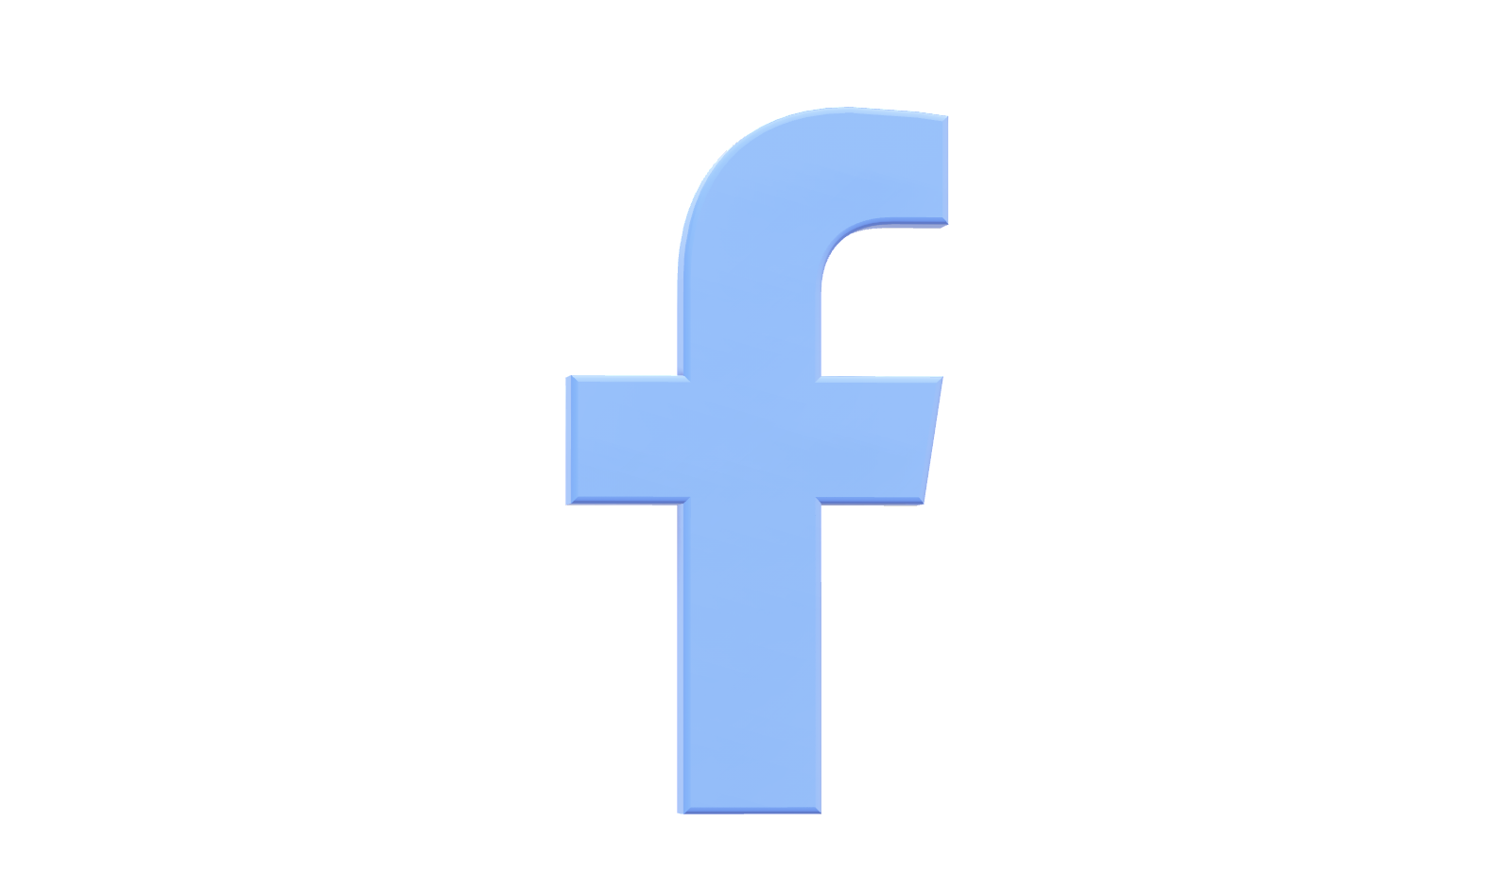
This is currently the most impactful social media platform in the world.
YouTube is a widely used video-sharing platform that allows users to upload, view and share videos across a wide range of collection topics. Launched in 2005, it has become a major source of entertainment, education and information for millions of people around the world. Users can find everything from music video tutorials to vlogs and documentaries, putting a spotlight on brands and viewers. With features like subscriptions, playlists, and live streaming, YouTube creates a dynamic community where creativity and interaction thrive.
Twitch is a live streaming platform primarily focused on video game content, allowing users to watch and interact with streamers in real-time. Launched in 2011, it has evolved into a vibrant community where gamers, artists, and creators can share their experiences and connect with audiences. In addition to gaming, Twitch features streams on music, art, and various other topics, making it a diverse hub for entertainment and engagement. With chat functionalities and interactive features, Twitch fosters a unique sense of community among viewers and streamers alike.
Discord is a communication platform designed for creating communities, originally popular among gamers. Launched in 2015, it offers voice, video, and text chat features, allowing users to connect in real-time through servers organized around various topics and interests. Whether for gaming, study groups, or hobbyist communities, Discord provides a space for collaboration and socializing. With customizable channels and robust moderation tools, it fosters vibrant, interactive environments for people to share, discuss, and connect.
Telegram is a cloud-based messaging app known for its focus on speed and security. Launched in 2013, it allows users to send messages, photos, videos, and files, as well as create groups and channels for broadcasting to larger audiences. With features like end-to-end encryption and self-destructing messages, Telegram emphasizes privacy and user control. Its versatility makes it popular for both personal communication and community building, accommodating a wide range of interests and interactions.
WhatsApp is a widely-used messaging app that allows users to send text messages, voice notes, photos, and videos over the internet. Launched in 2009, it enables real-time communication through one-on-one chats or group conversations. With features like end-to-end encryption, voice and video calls, and status updates, WhatsApp prioritizes user privacy and connectivity. Its simplicity and accessibility have made it a go-to app for millions around the world, facilitating both personal and professional communication.
Social media refers to digital platforms and applications that allow users to create, share and interact in real time. From Facebook and Twitter to Instagram and TikTok, these platforms facilitate networking, networking and community building across a range of interests and demographics. Social media has changed the way people communicate, share information and interact with brands, becoming an essential tool for personal expression, marketing and social development Its impact on society is profound, affecting trends, opinions in the modern world.

